Slide 1


Front-End 101
>html>The High Level Basics</html>

Slide 2
Table of Contents
What will we cover?
Introduction to the Internet
HTML
CSS

Slide 3
Introduction to the Internet

Slide 4
Introduction to the Internet
what where why when who whom how…WawaWiwa:
The WWW was invented by the European Center for Nuclear Research (CERN) In 1962
the first version of the Internet, was founded in 1969 by the Advanced Research Projects Agency (ARPA)
in the first half of the 1990s, the Internet became a public domain, thanks to the spread of the WWW

Slide 5
Introduction to the Internet
How it’s work ?

Slide 6
Introduction to the Internet
Basic Concepts
Client - A computer that receives the information that sent from the Web Server, the Client must have a software that can receive response from Web Server, We know this software as Web Browser.
Web Server - Computers that run a Web Server Software. and them sending us, users, web content (like websites), but all data is stored in the Web Server. A web page usually is written in HTML language.

Slide 7
Introduction to the Internet
Basic Concepts
Web Browsers - A Browser is a software that gives ability to communicate through the internet and get information from the Web Servers.
Major Web Browsers: Google Chrome, Mozilla Firefox, Internet Explorer…
Communications Protocol (HTTP) - The way that computer communicate on internet is with a protocol called HTTP. Hypertext Transfer Protocol is the way that computers communicate, Clients send a HTTP Requests. Servers send a HTTP Response. Apache Server and Chrome Browser both know to communicate with HTTP.

Slide 8
Introduction to the Internet
Basic Concepts
IP Address - For all computers be able to communicate they need a unique address, behind all URL address there is the actual unique identifier called "IP Address".
Clients, Servers and other devices have there own IP address, so when a client want to send a request to the server he knows it's unique address.
Example - Google IP it's 173.194.78.104

Slide 9
<html>

Slide 10
<Structure> & <Content> - HTML
Stands for Hyper Text Markup Language
Consist of nested tags, which constitute the content of the page
Includes text, links, images, forms etc.
Based on the hierarchy concept (tree). Nesting is meaningful
The newest version is HTML 5 (and the most usable one these days…)
Interesting fact – the original use HTML was to pass documents
No look & feel included. “stripped” of any style.

Slide 11
<Structure> & <Content> - HTML
To understand that connection, we need to go
Back to Basics

Slide 12
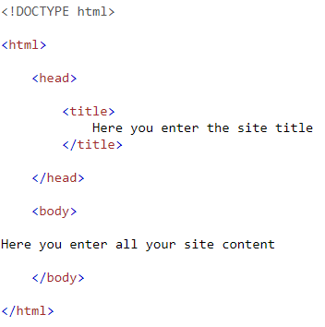
<Structure> & <Content> - HTML

Slide 13
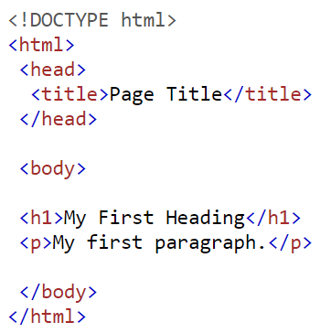
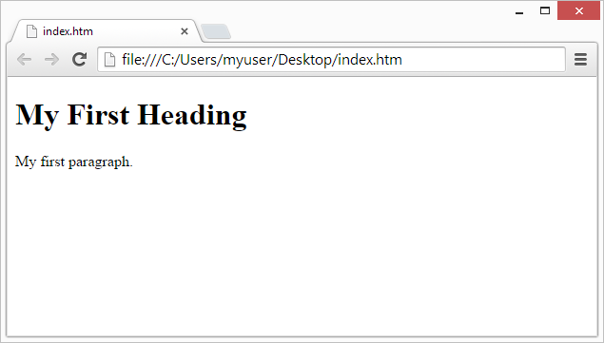
<Structure> & <Content> - HTML

Slide 14
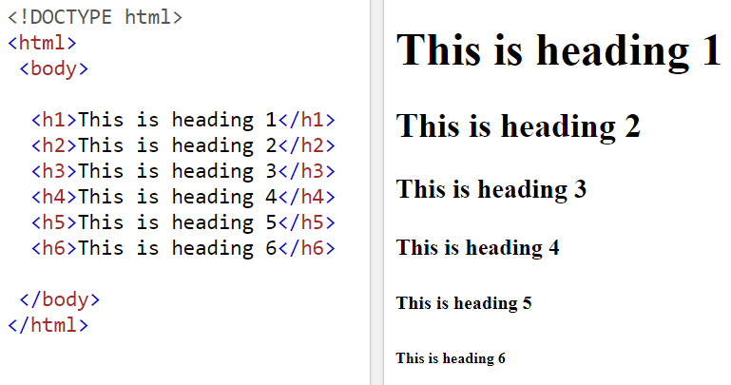
<Structure> & <Content> - HTML

Slide 15
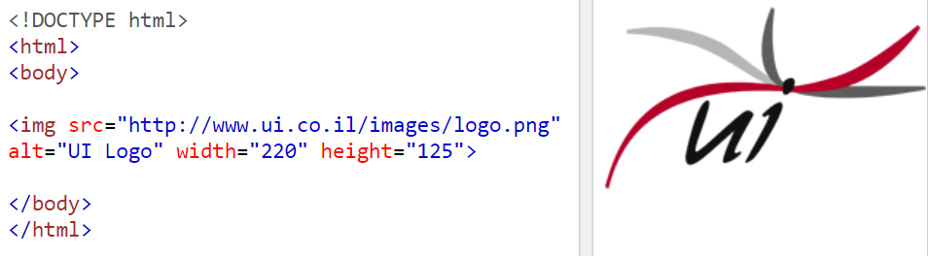

<Structure> & <Content> - HTML

Slide 16
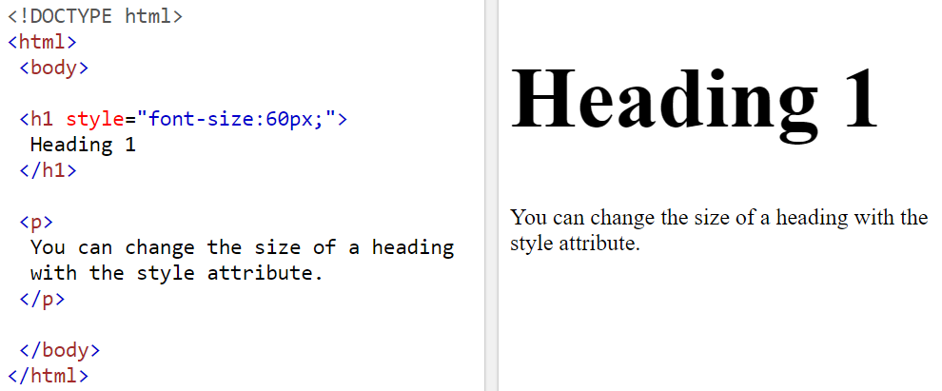
<Structure> & <Content> - HTML

Slide 17
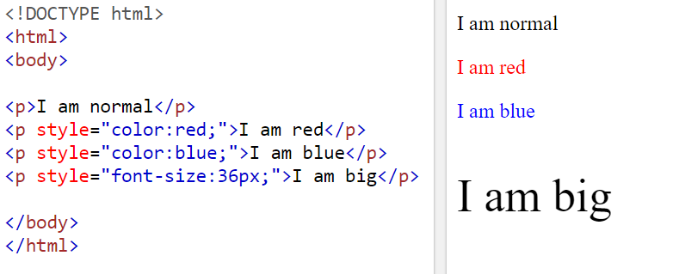
<Structure> & <Content> - HTML

Slide 18
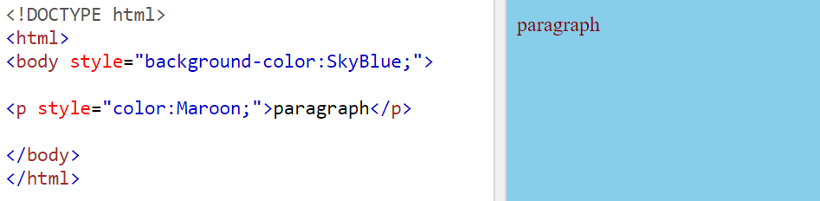
<Structure> & <Content> - HTML

Slide 19
<CSS>

Slide 20
The Style - CSS
Stands for Cascading Style Sheets
Defines the look & feel of the page
Consist of selectors that contains properties with certain values
Controls the layout of multiple web pages all at once
We can define style to the HTML elements we have just made
A demonstration of the selectors way of behavior will be given
Several properties with certain values will be used

Slide 21
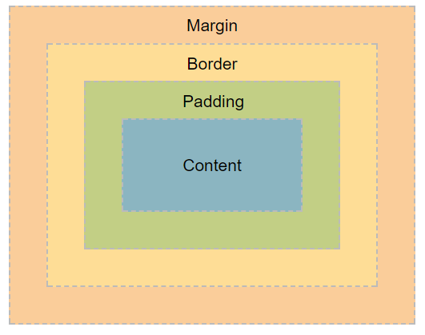
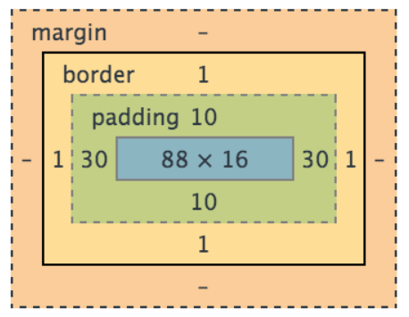
The Style - CSS
CSS Box Model

Slide 22
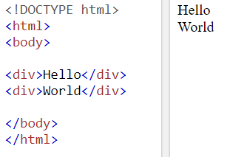
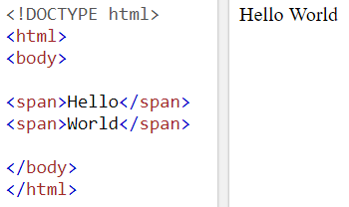
The Style - CSS
Block Element VS Inline Element

Slide 23
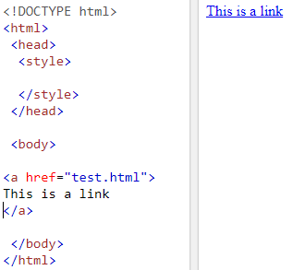
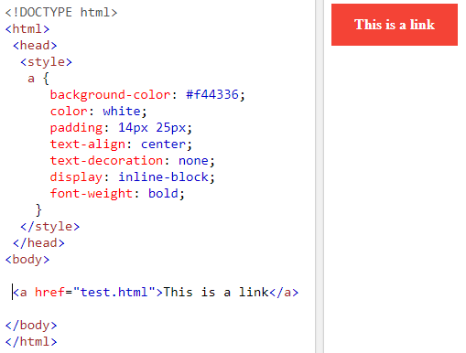
The Style - CSS
Without CSS VS With CSS

Slide 24
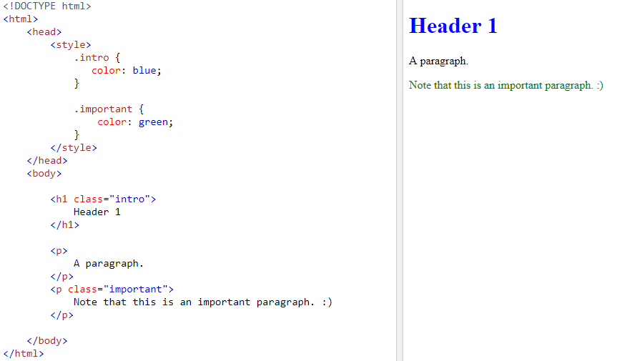
The Style - CSS
CSS Classes

Slide 25
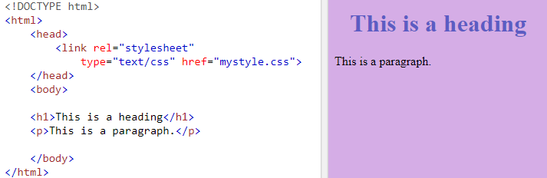
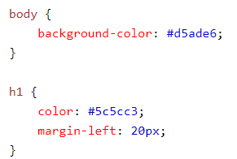
The Style - CSS
Import CSS file
index.html
mystyle.css

Slide 26
<HTML Layout>

Slide 27
Tags - HTML
Start tag | Purpose
Basic Tags
<html> | Set up an html page
<body> | Set the page body – content
<h1> to <h6> | Set headers of different sizes (1 to 6)
<p> | Paragraph definition
<br> | New line entry
Links
<a> | Set link anchor. The link itself is written in the href attribute within the tag.
Frames
<iframe> | Set a frame from the page itself
Input
<form> | Setting up a form for inserting data, adding buttons,
<input> | Inserting objects such as a text box, button, radio buttons,
<textarea> | Allows the user to write multiple lines
<button> | button
<select> | Selection box
<option> | A choice
<label> | label
Lists
<ul> | Defines a list in which each item will be displayed by a bullet
<ol> | Defines a list in which each item will be displayed by a number or letter
<li> | Set up a list item
Images
<img> | Insert image. The image address will be written in the src property
Tables
<table> | Setting up a table
<th> | Sets the header row in the table
<tr> | Set up a table row
<td> | Set up a table cell
Styles
<div> | Set up a separate page section
<span> | Set up a separate page section
Meta Info
<style> | Set up a comprehensive design for a page
<head> | Defines the declarative portion of the page
<title> | Set a page title

Slide 28
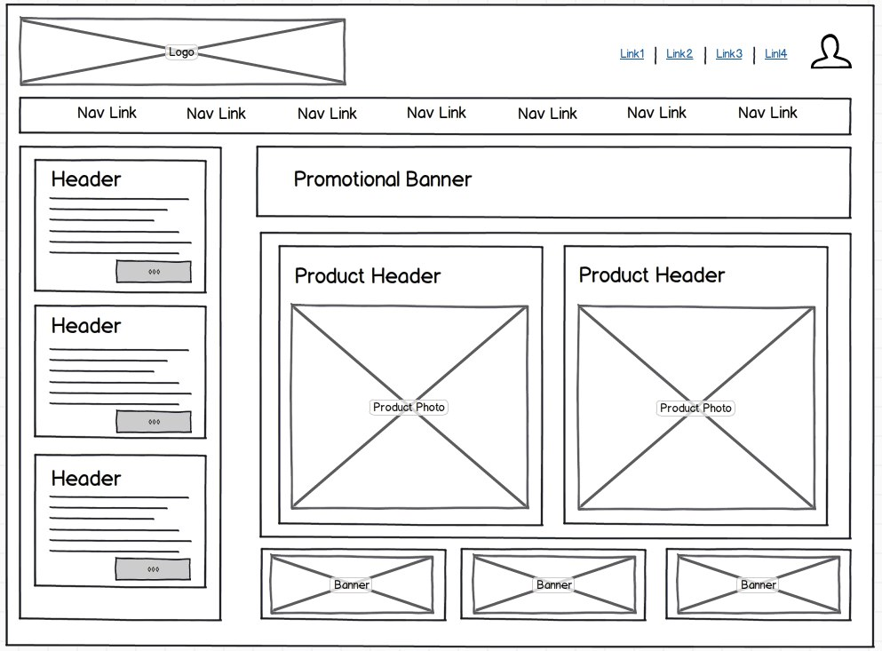
HTML Layout
Do you recognize this?

Slide 29
HTML – Container Elements
Header
Aside
Main

Slide 30
HTML – Basic Elements
div
h1
p
button
a

Slide 31

תודה!

